Slide 1

Job Recommendation System
Harsh Mulik 21107044
Tanvi Mirgal 21107028
Sakshi Jamdhade 21107042
Meghraj Padwal 21107025
Project Guide
Prof. Aishwarya Londhe

Slide 2

1. Introduction
This project presents a Job Recommendation System based on Content-Based Filtering techniques. The system analyzes job descriptions and matches them with user-entered skills and preferences to provide personalized job suggestions.
Problem Identified :
Job seekers often struggle with information overload, irrelevant listings, and a lack of personalized recommendations on traditional job portals.
Solution Proposed :
A Content-Based Recommendation System that analyzes job postings and user preferences to recommend jobs based on textual similarity..

Slide 3

2. Objectives
To develop a content-based recommendation model that matches user-entered skills with job descriptions using text similarity techniques.
To implement web scraping for extracting up-to-date job listings from online job portals.
To apply NLP techniques like TF-IDF vectorization for feature extraction and comparison of job content with user profiles.
To create a user-friendly interface that allows users to input their preferences and receive personalized job recommendations.

Slide 4

3. Scope
Its content-based nature allows it to adapt to various fields by focusing on the textual relevance between job descriptions and user profiles.
The system can be seamlessly integrated into existing job portals or career websites to enhance their recommendation features. By doing so, it improves the user experience on such platforms by providing personalized and relevant job listings without the need for extensive manual filtering.
Additionally, the architecture of the system is extensible, meaning it can evolve over time. Future enhancements may include incorporating user feedback, such as clicks or job applications, to further refine the recommendations.

Slide 5
4. Feature /Functionality
Data scraping from job sites (e.g., LinkedIn, Indeed).
Use of TF-IDF Vectorizer to extract job description features.
Cosine Similarity to measure relevance between jobs and user profile.
Interactive dashboard for entering skills and viewing recommendations.

Slide 6

5. Outcome of Project
The project successfully resulted in the development of a fully functional job recommendation engine capable of delivering personalized job suggestions to users.
Through the use of TF-IDF vectorization and cosine similarity, the system achieved high accuracy in identifying and ranking jobs that are most relevant to the user
Users benefited from a more efficient and targeted job search experience, reducing the time and effort required to sift through unrelated job postings.
With its modular and scalable design, the system can be extended with additional features such as feedback loops, user behavior tracking, and integration with advanced machine learning algorithms, paving the way for an intelligent and adaptive job matching platform.

Slide 7
6. Technology Stack
Algorithms Used
Language: Python
Libraries: scikit-learn, BeautifulSoup, Pandas, NumPy
NLP Tools: TF-IDF Vectorizer, Cosine Similarity
Web Scraping: BeautifulSoup / Scrapy
Frontend : Streamlit / Flask / Web-based UI
Environment: Jupyter Notebook / VS Code
BackEnd
OpenCV
Servelit
MySQL

Slide 8

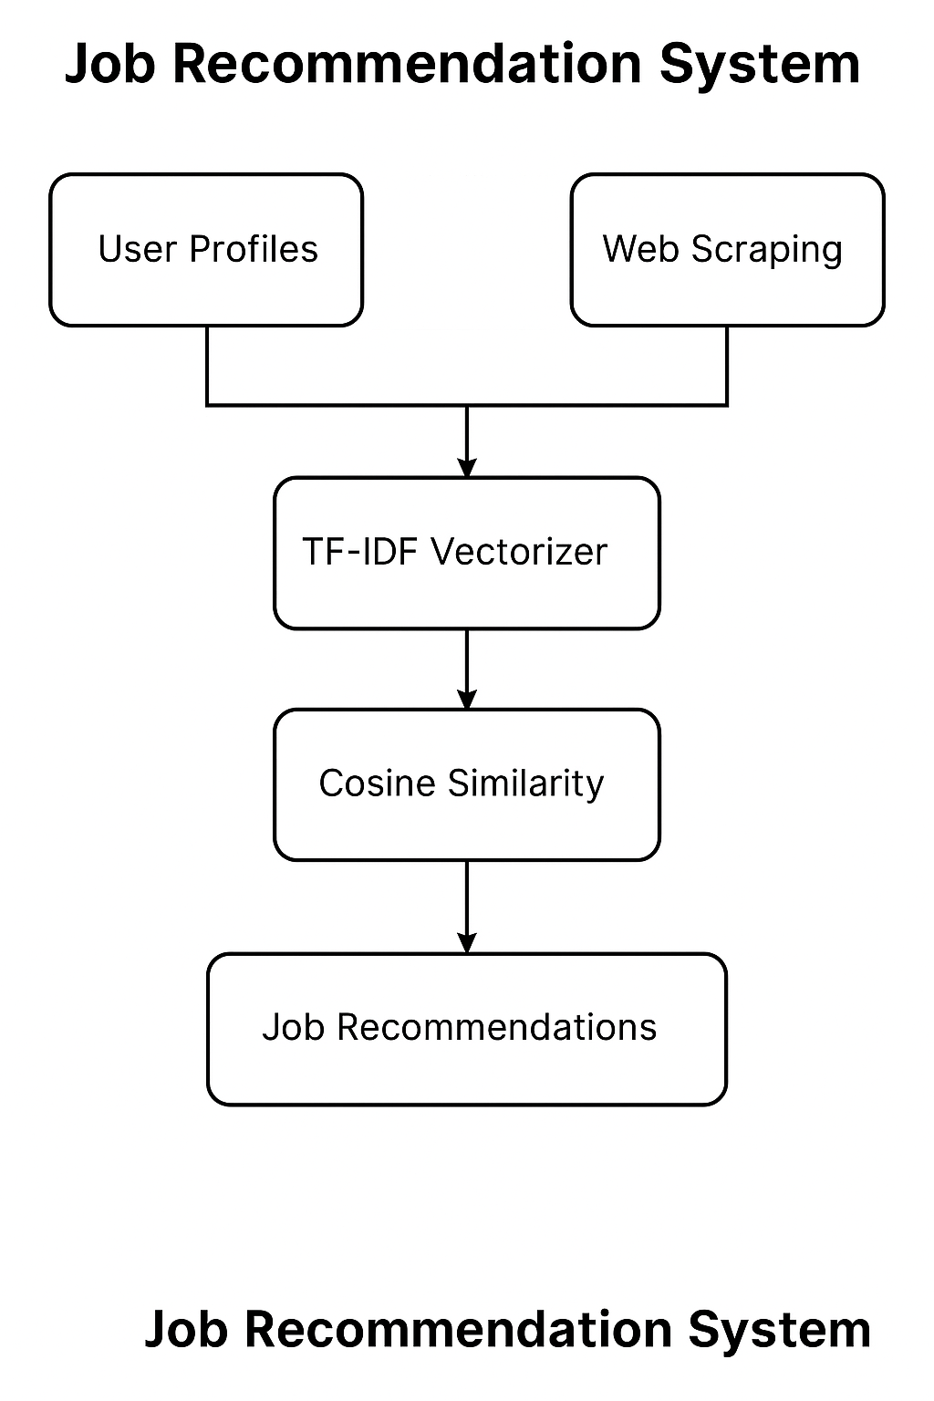
7. Block Diagram

Slide 9
Thank You...!!

